Slide 1



Reproducible data collection, curation, validation and management The trait wheelTM
You can write unit / affiliation. leave blank if not applicable. To change content go to: Menu -> Insert (Mac = Display) -> Header and Footer
PFTC6 – Norway
Aud Halbritter
aud.halbritter@uib.no
@audhalbritter

Slide 2
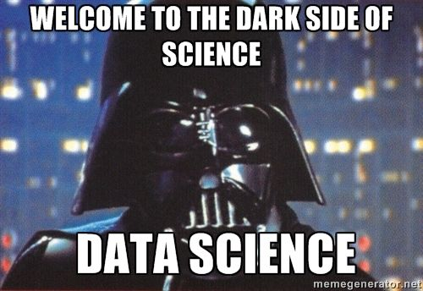

Slide 3
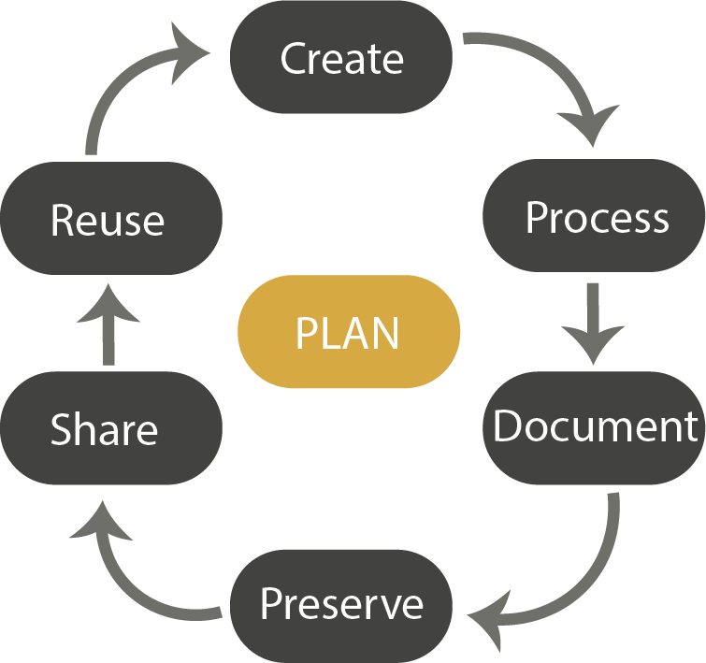
The data life cycle

Slide 4
The data life cycle

Slide 5
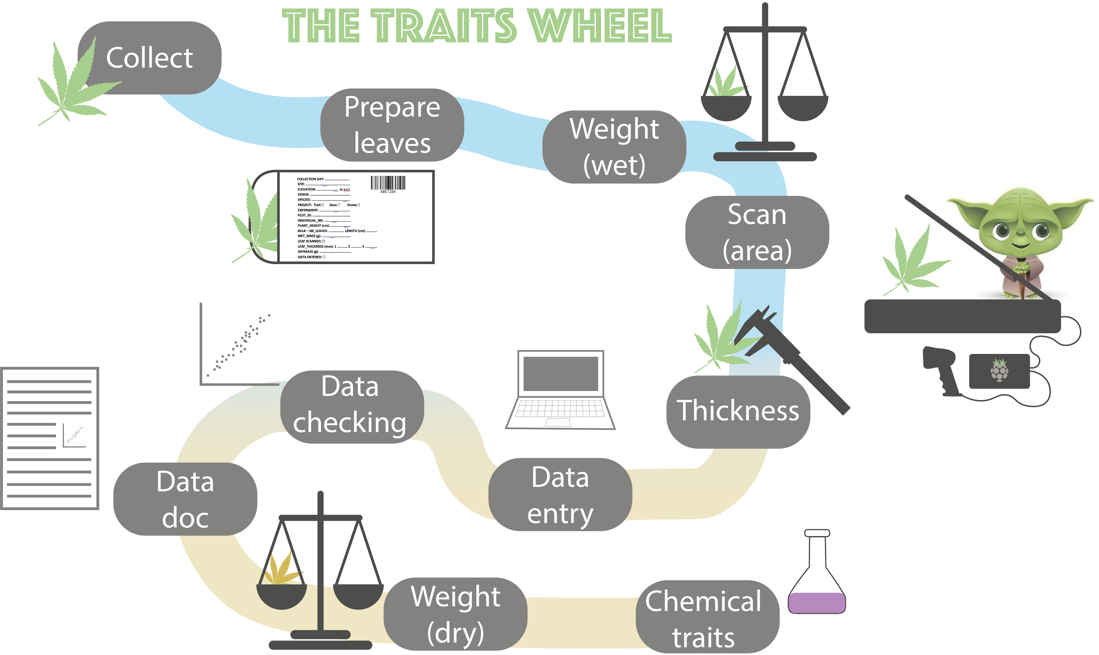

Slide 6

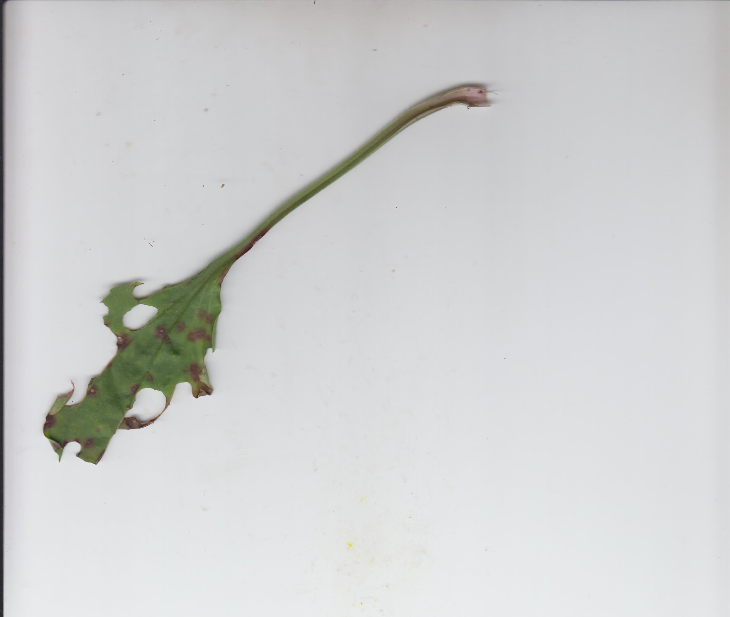
Create – collect leaves
Collect „good“ plant material

Slide 7
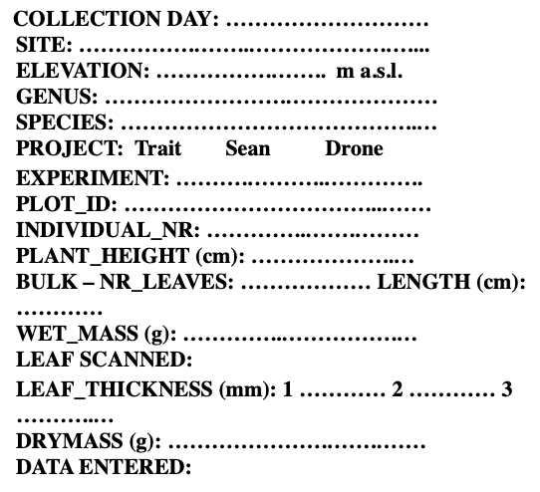
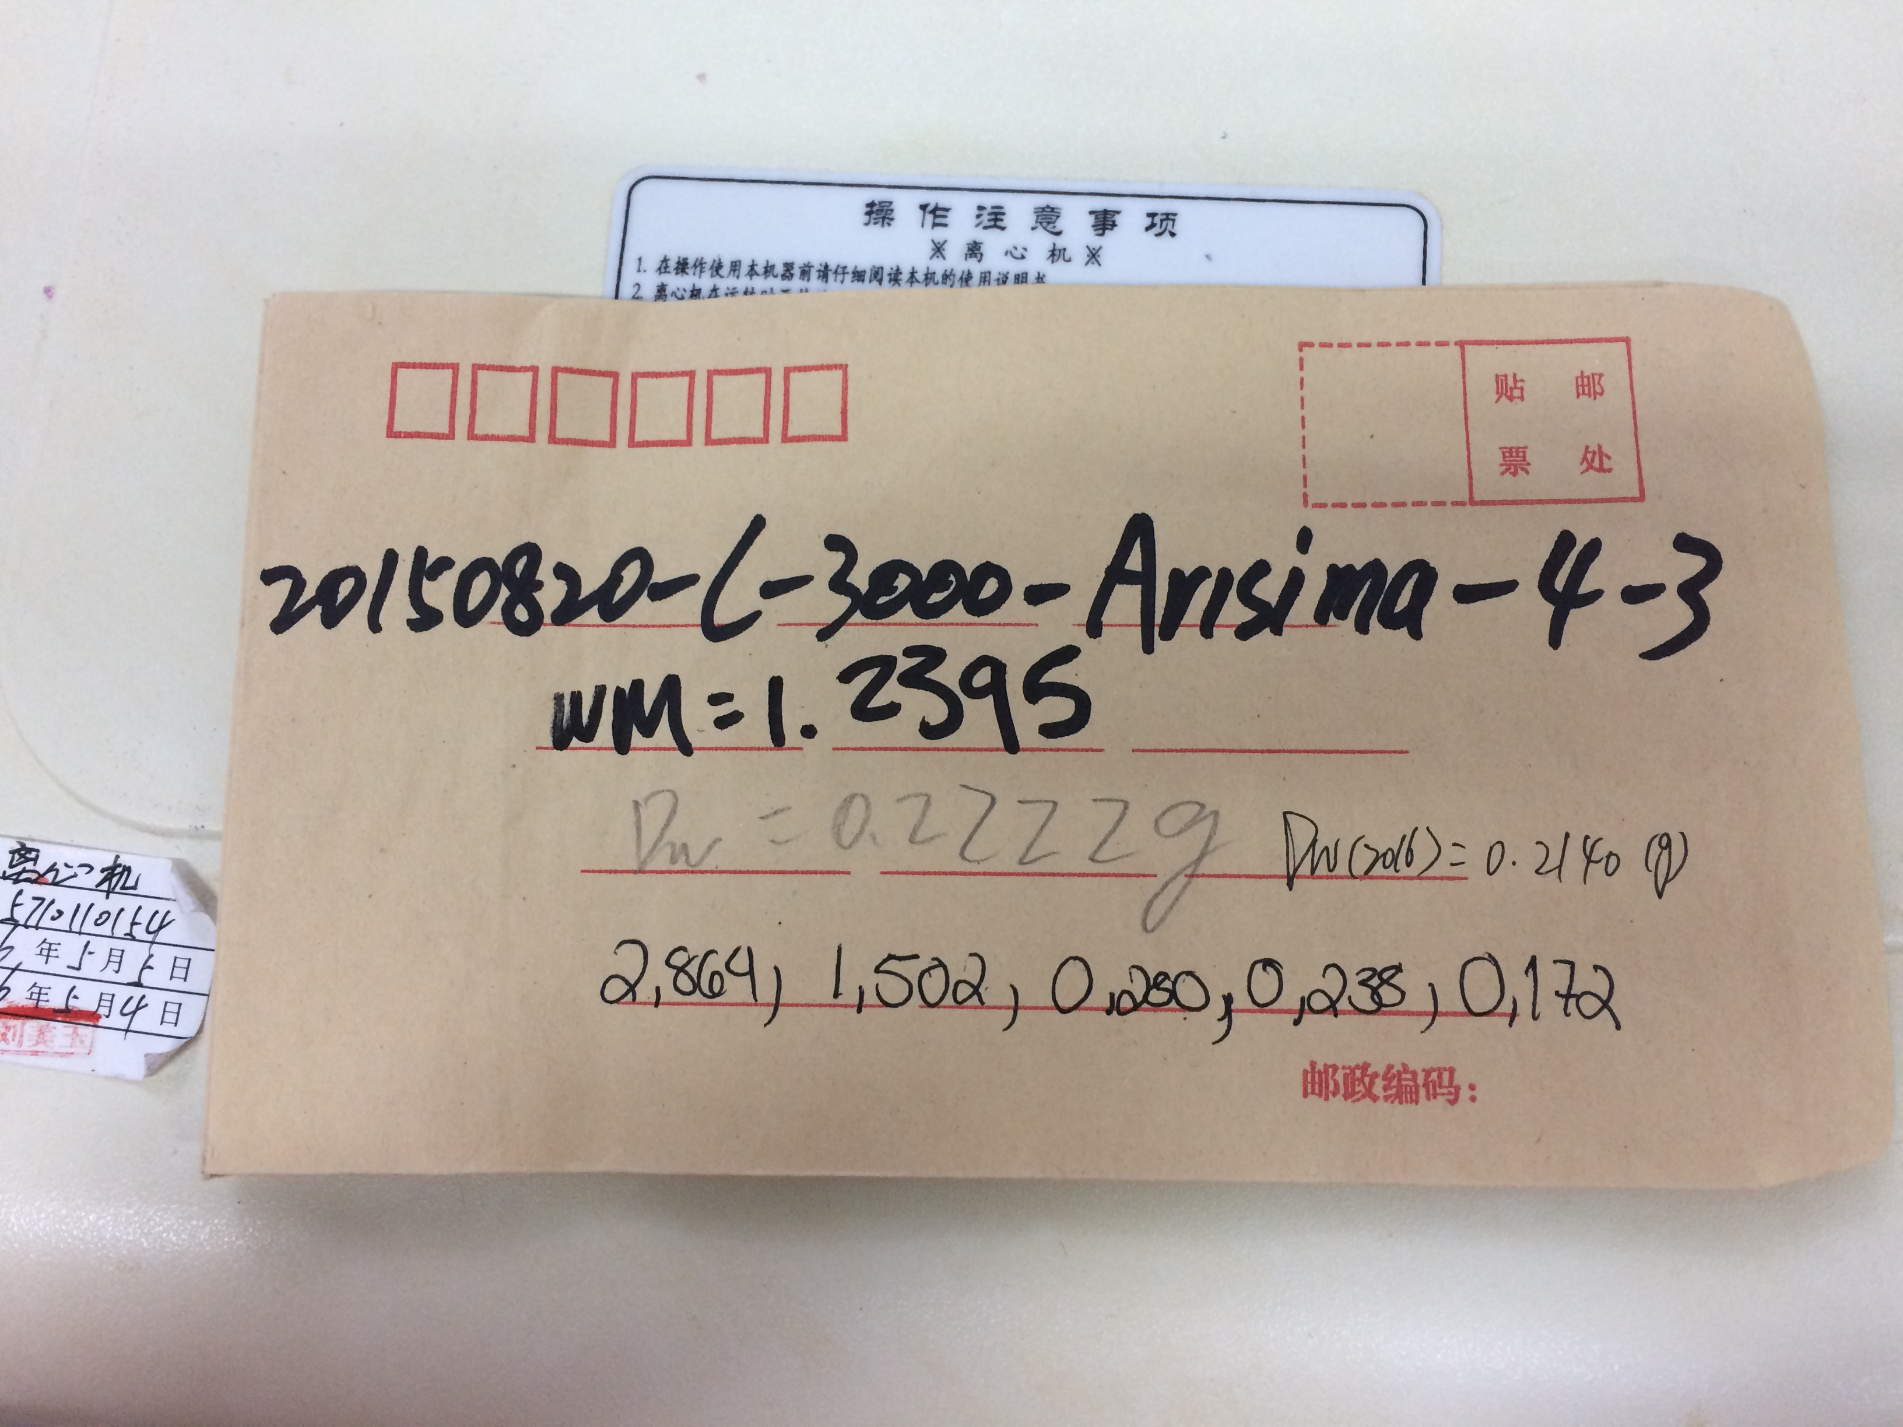
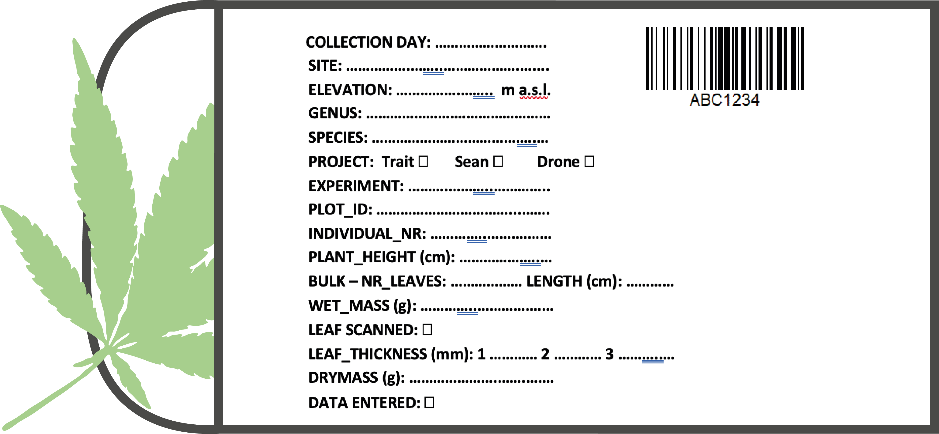
Create – Prepare the leaves
Label your samples
Take notes!

Slide 8
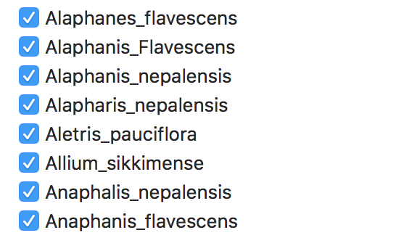
Create – Prepare
Unique sample ID
AAA1234
Barcode
https://github.com/Plant-Functional-Trait-Course/PFTCFunctions/blob/master/R/make_barcode_labels.R
R package: baRcodeR

Slide 9

Create - Weight
Calibrate balances
Write down the weight with all digits
Use standardized unit

Slide 10

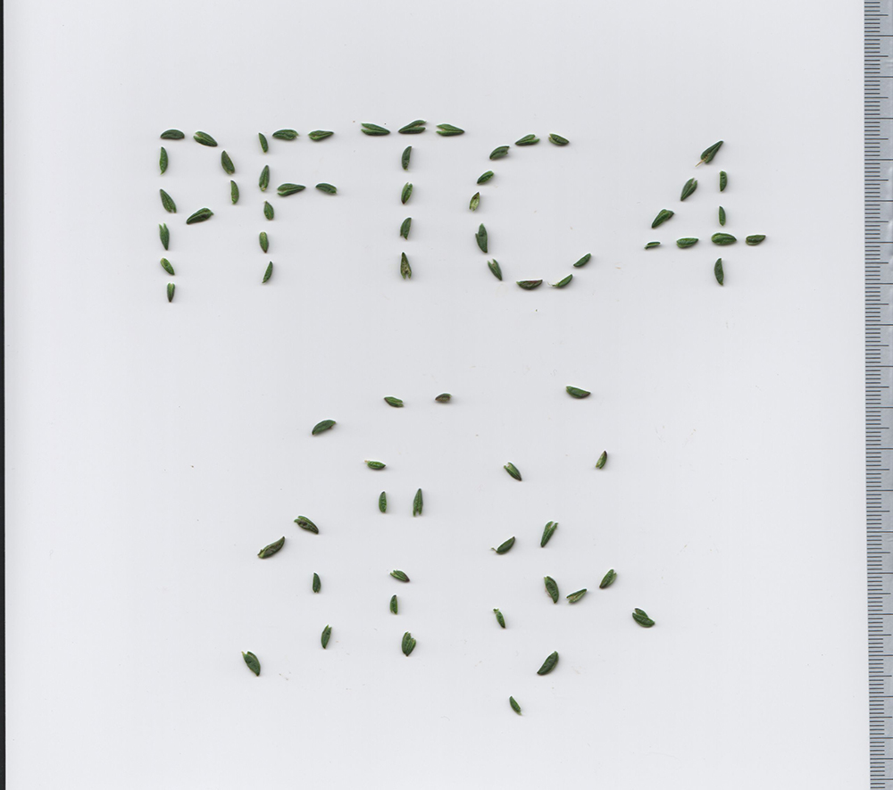
Create - Scanning

Slide 11
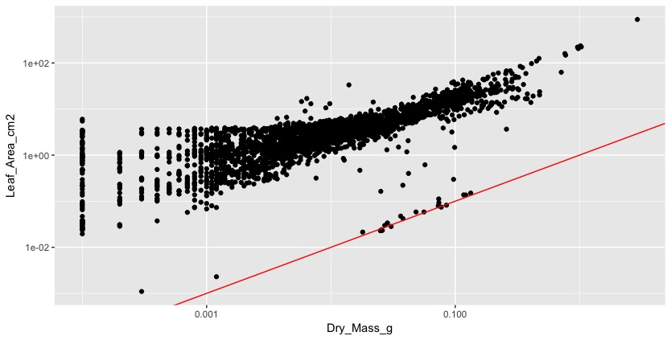

Process – Data validation

Slide 12
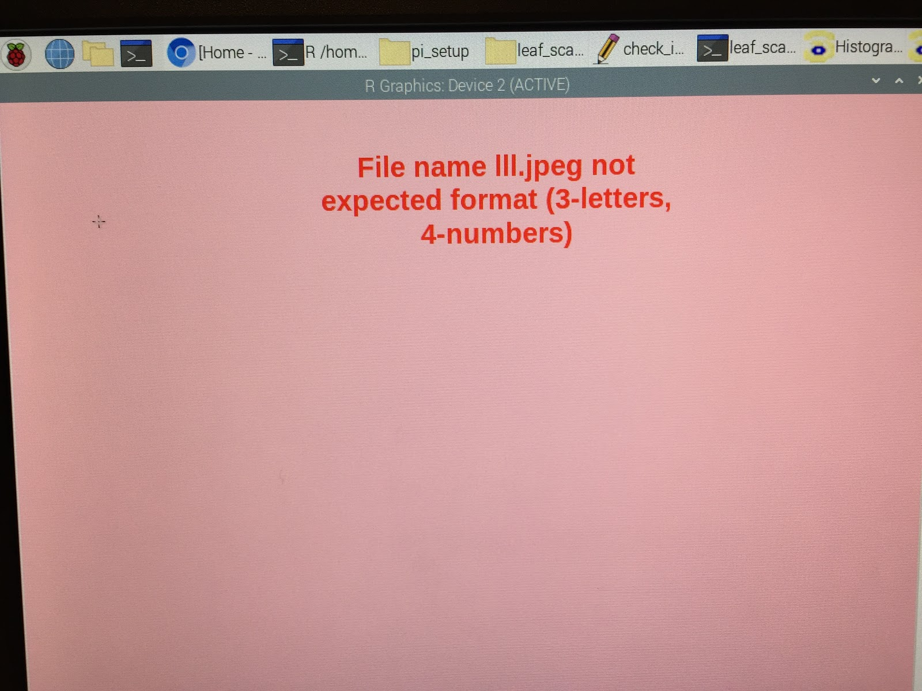
Create - Scanning

Slide 13

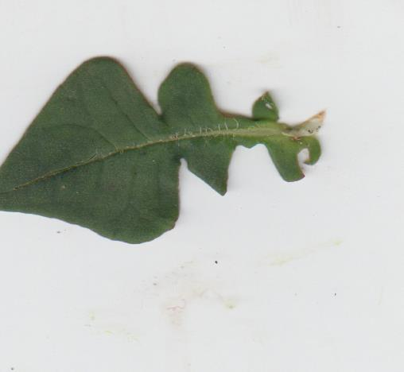

Create - Scanning

Slide 14
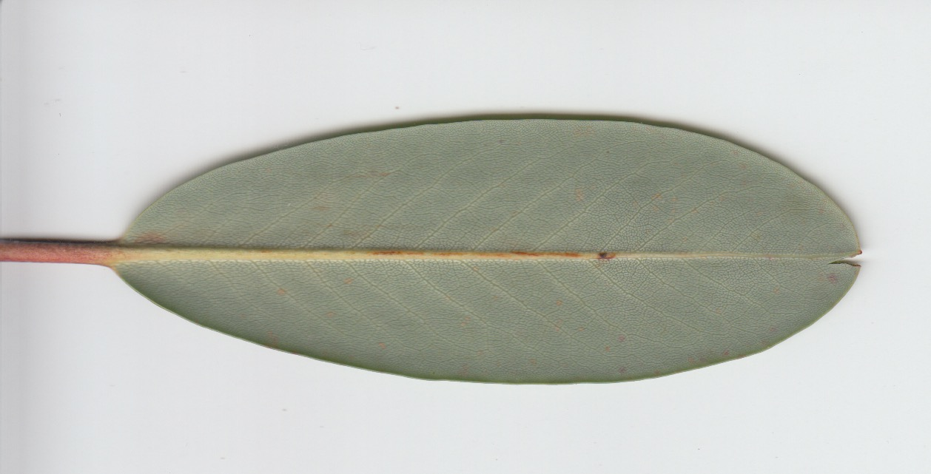
Create - Scanning

Slide 15
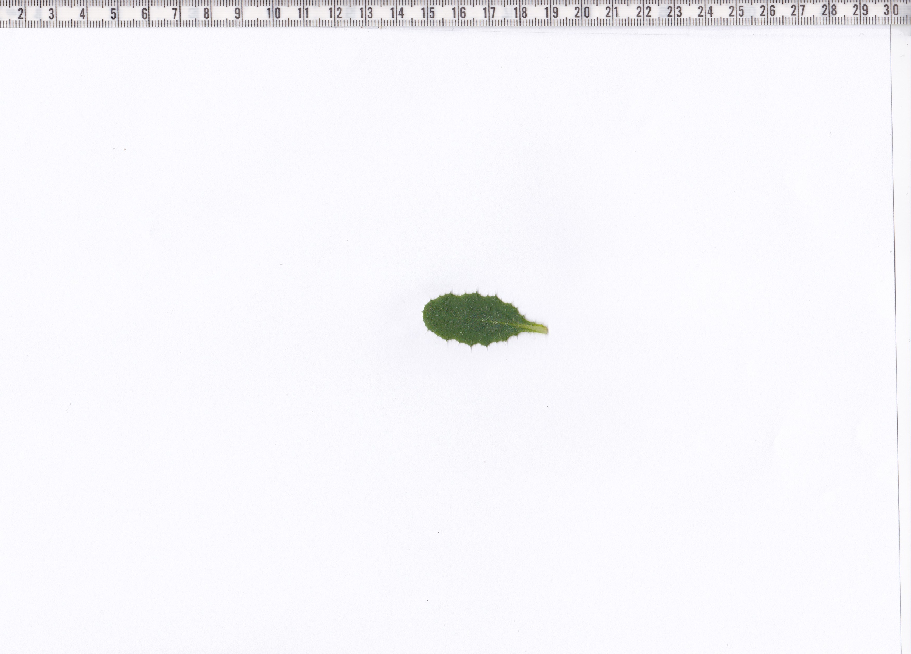
Create - Scanning

Slide 16

Create – Calculate Leaf Area
Code: https://github.com/Plant-Functional-Trait-Course/PFTC6_Norway/blob/main/R/traits/CalculateLeafArea.R
ImageJ
R package: LeafArea
Custom function: devtools::install_github("richardjtelford/LeafArea")
library(LeafArea)
Function to process multiple scans
(loop.files)

Slide 17
Create - Calculate Leaf Area
#### Function to calculate leaf area
loop.files <- function(files){
file.copy(files, new.folder)
print(files)
area <- try(run.ij(set.directory = new.folder, distance.pixel = 237, known.distance = 2, log = TRUE, low.size = 0.005, trim.pixel = 60, trim.pixel2 = 150, save.image = TRUE))
if(inherits(area, "try-error")){
return(data.frame(LeafArea = NA))
}
file.copy(dir(new.folder, full.names = TRUE, pattern = "\\.tif"), output.folder)
Sys.sleep(0.1)
if(any(!file.remove(dir(new.folder, full.names = TRUE) ))) stop()
res <- data.frame(ID = names(unlist(area[[2]])), LeafArea = (unlist(area[[2]])))
return(res)
}

Slide 18

Create - Thickness
Measure leaf thickness 3 times for each sample avoiding the mid rib.
If the leaf is too small make less measurements. The measurments should not overlap.

Slide 19

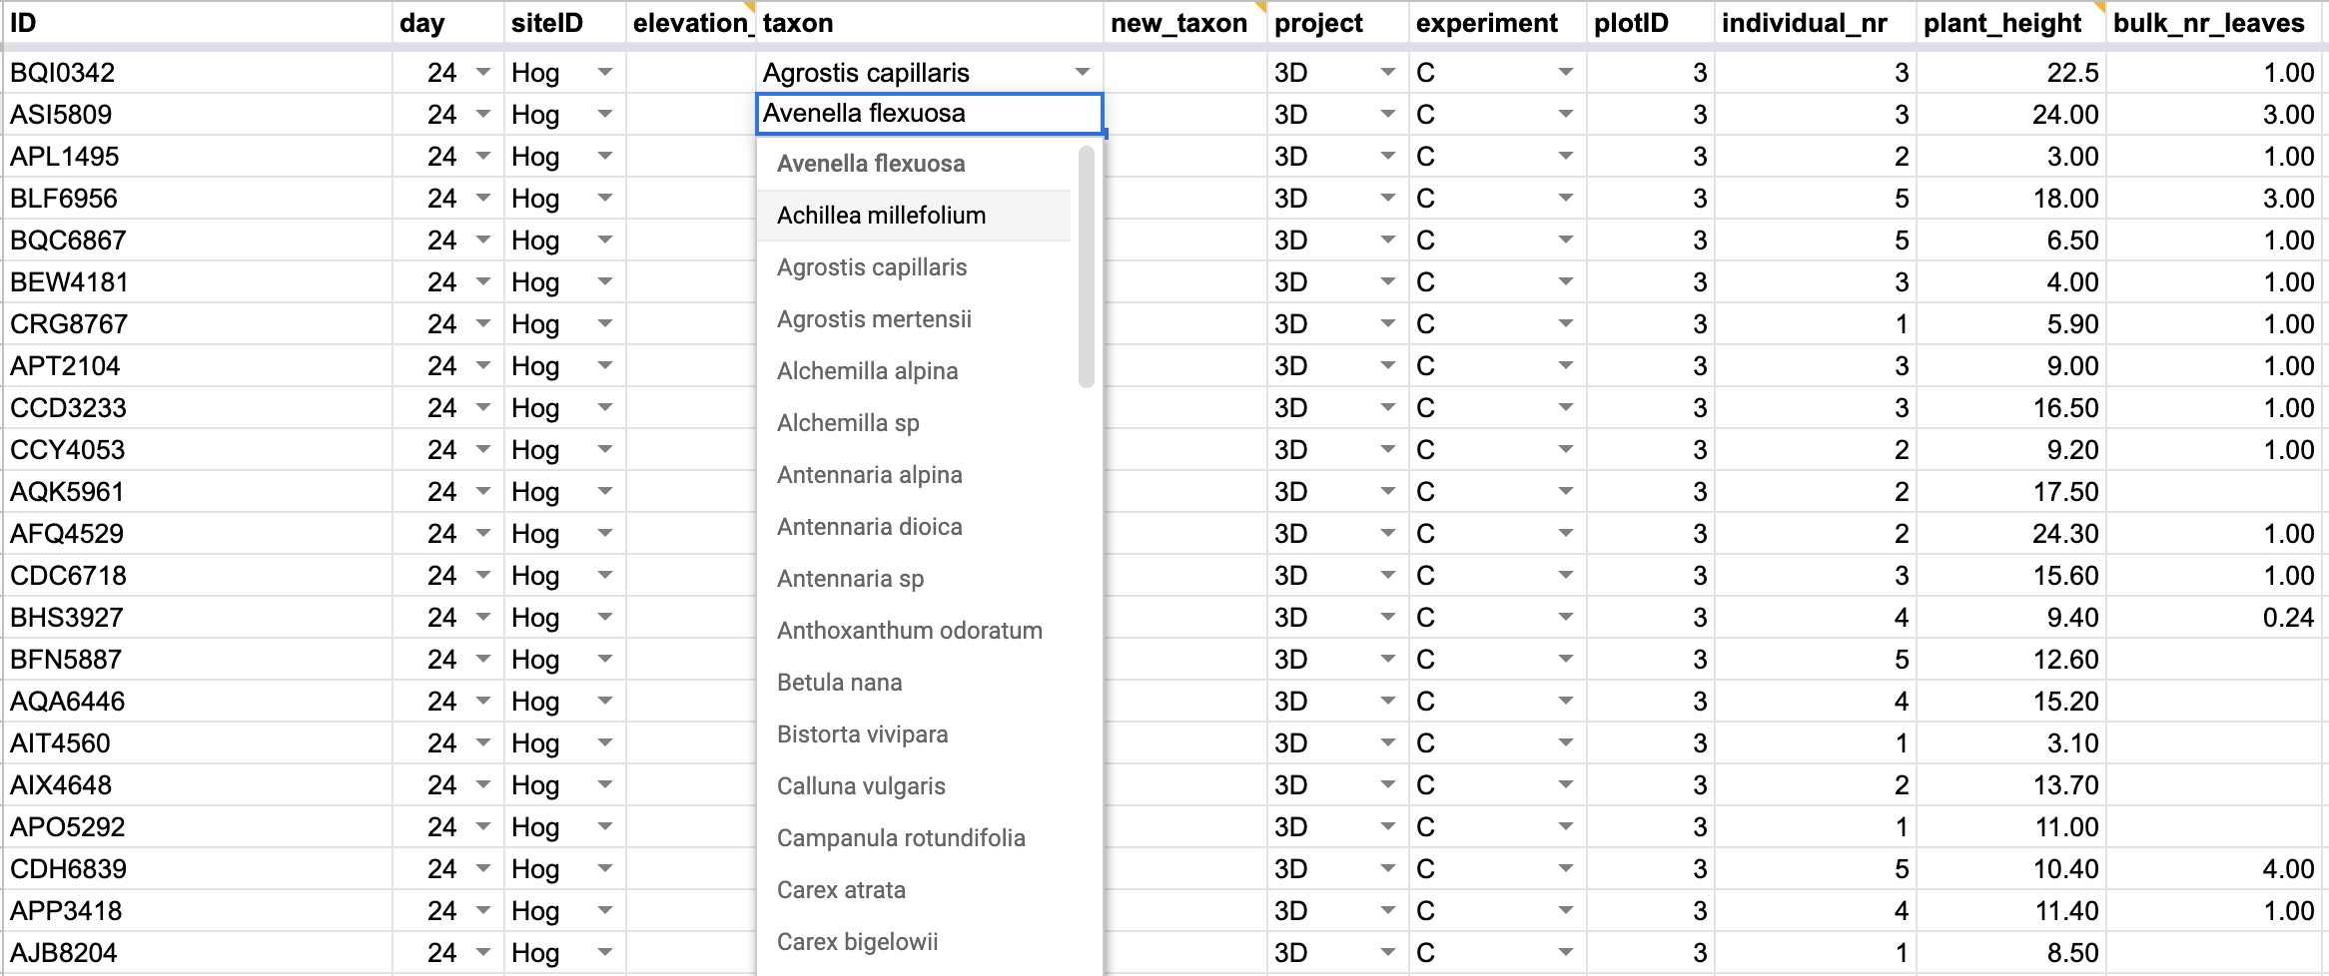
Process – Data entry

Slide 20
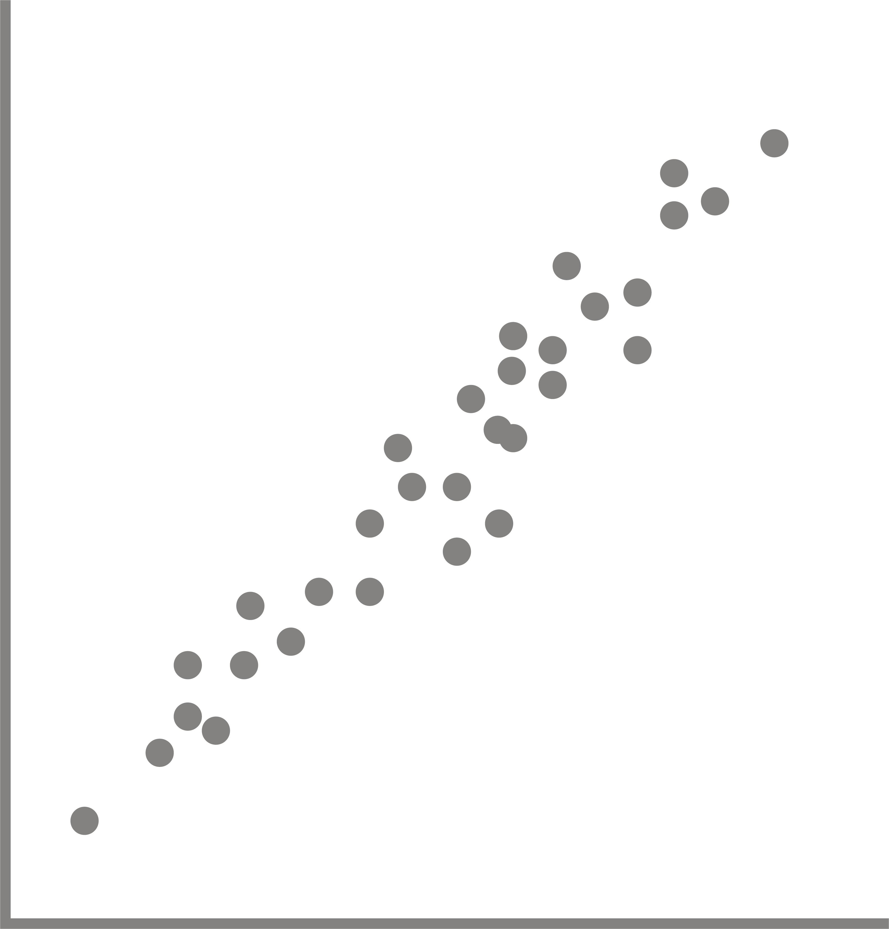
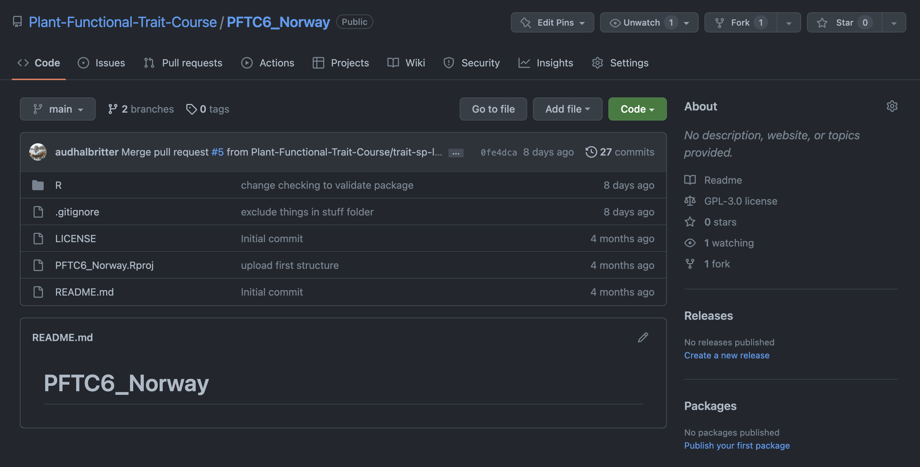
Process – Import and checking

Slide 21
Why Git and GitHub
Easy to share code with collaborators, students, etc.
Collaborators can work on the same code at the same time
Keeping track of changes in the code

Slide 22
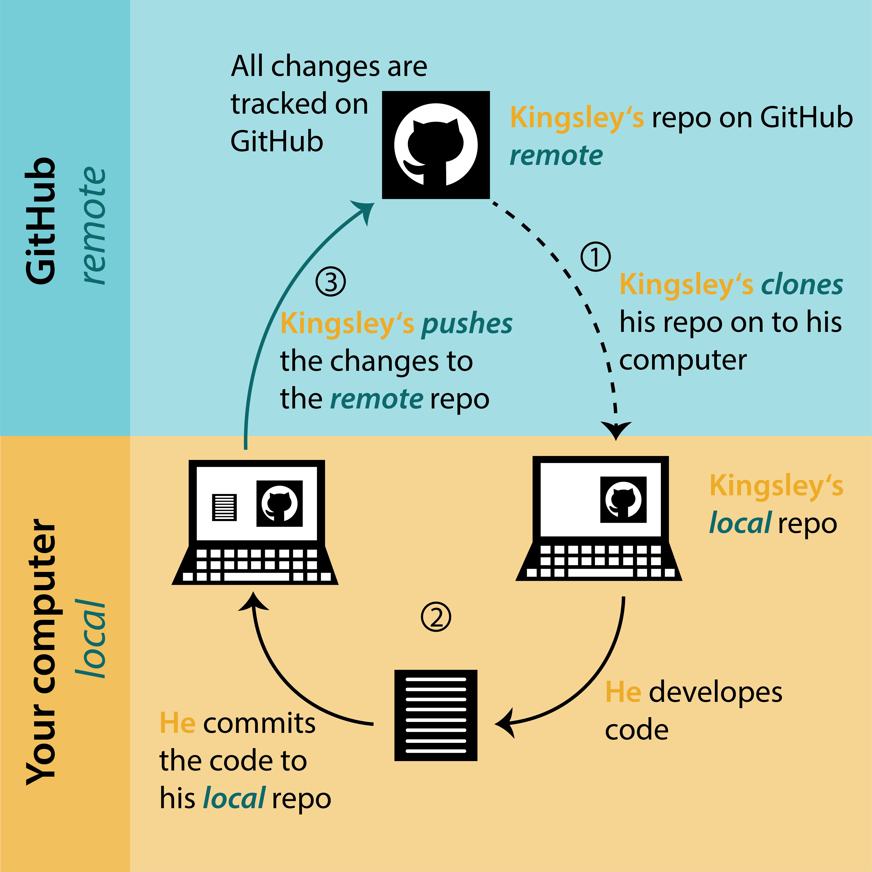
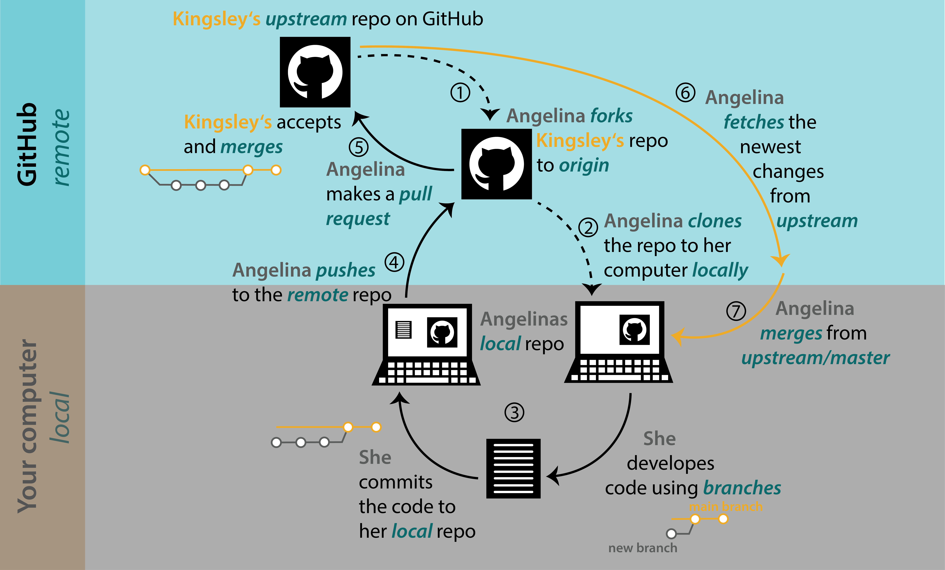
https://biostats-r.github.io/biostats/github/index.html

Slide 23
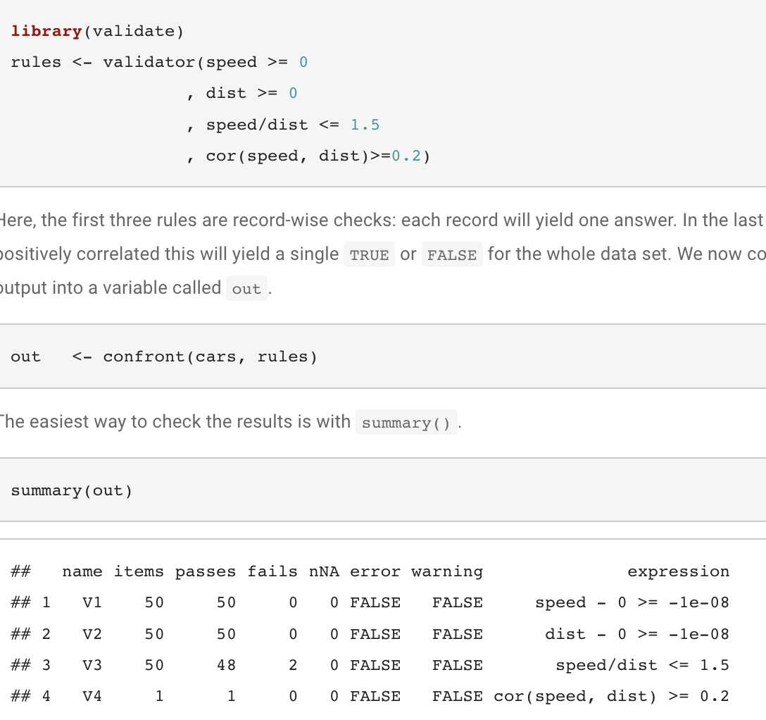
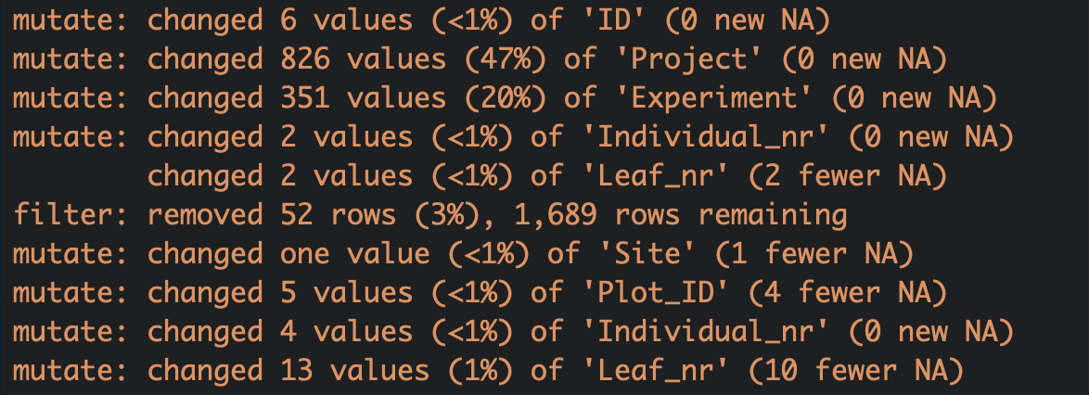
Process – data checking
tidylog
feedback for basic
dplyr operations
https://plant-functional-trait-course.github.io/PFTC_teaching_material/index.html

Slide 24
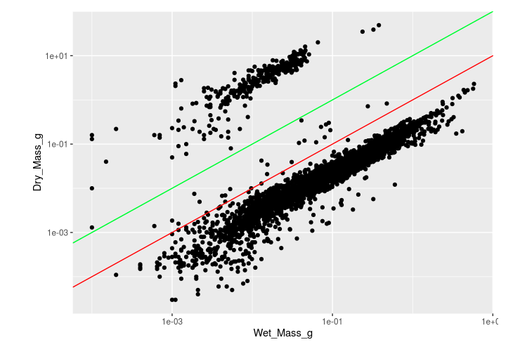
Process – Data validation
Plot data
wet mass vs. dry mass
Wet/dry mass vs. leaf area
Leaf thickness 1 vs leaf thickness 2 etc.
Log scale if necessary
Check outliers
Check unrealistic values
SLA > 500 g/cm2
SLA < 5 g/cm2
LDMC > 1
Weighing error: 1000 x smaller (mg)

Slide 25
Process – some numbers
 | China (2x) | Peru 1* | Svalbard | Peru 2** | Norway
# leaves | 6734 | 3071 | 1469 | 1534 | 2117***
Total wet mass (g) | 1141 | 836 | 132 | 248 | 296.96***
Total leaf area (cm²) | 42353 | 23021 | 5666 | 7505 | ?
Lines of R code | 522 + 1 year playing with Excel | 393 ++ | 399 | 205 | 0
*not all chemical traits collected yet
** not all leaves processed yet
*** at 9:07 on the 31. July 2022

Slide 26
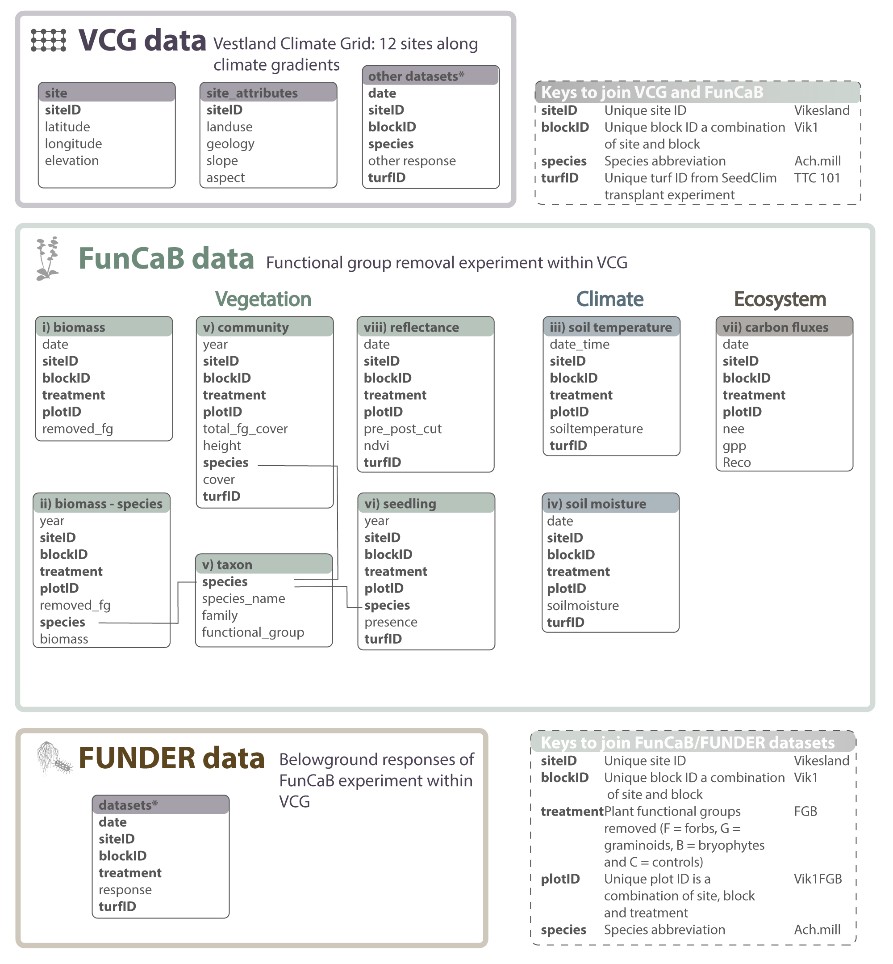

Document – Data documentation
Data paper: https://www.nature.com/articles/s41597-022-01559-0
ThreeD data paper: https://docs.google.com/document/d/1IIjCE78nI-Ht7GW6HPpIOAKV1Ksm1j2MomKQMYJLQBk/edit

Slide 27
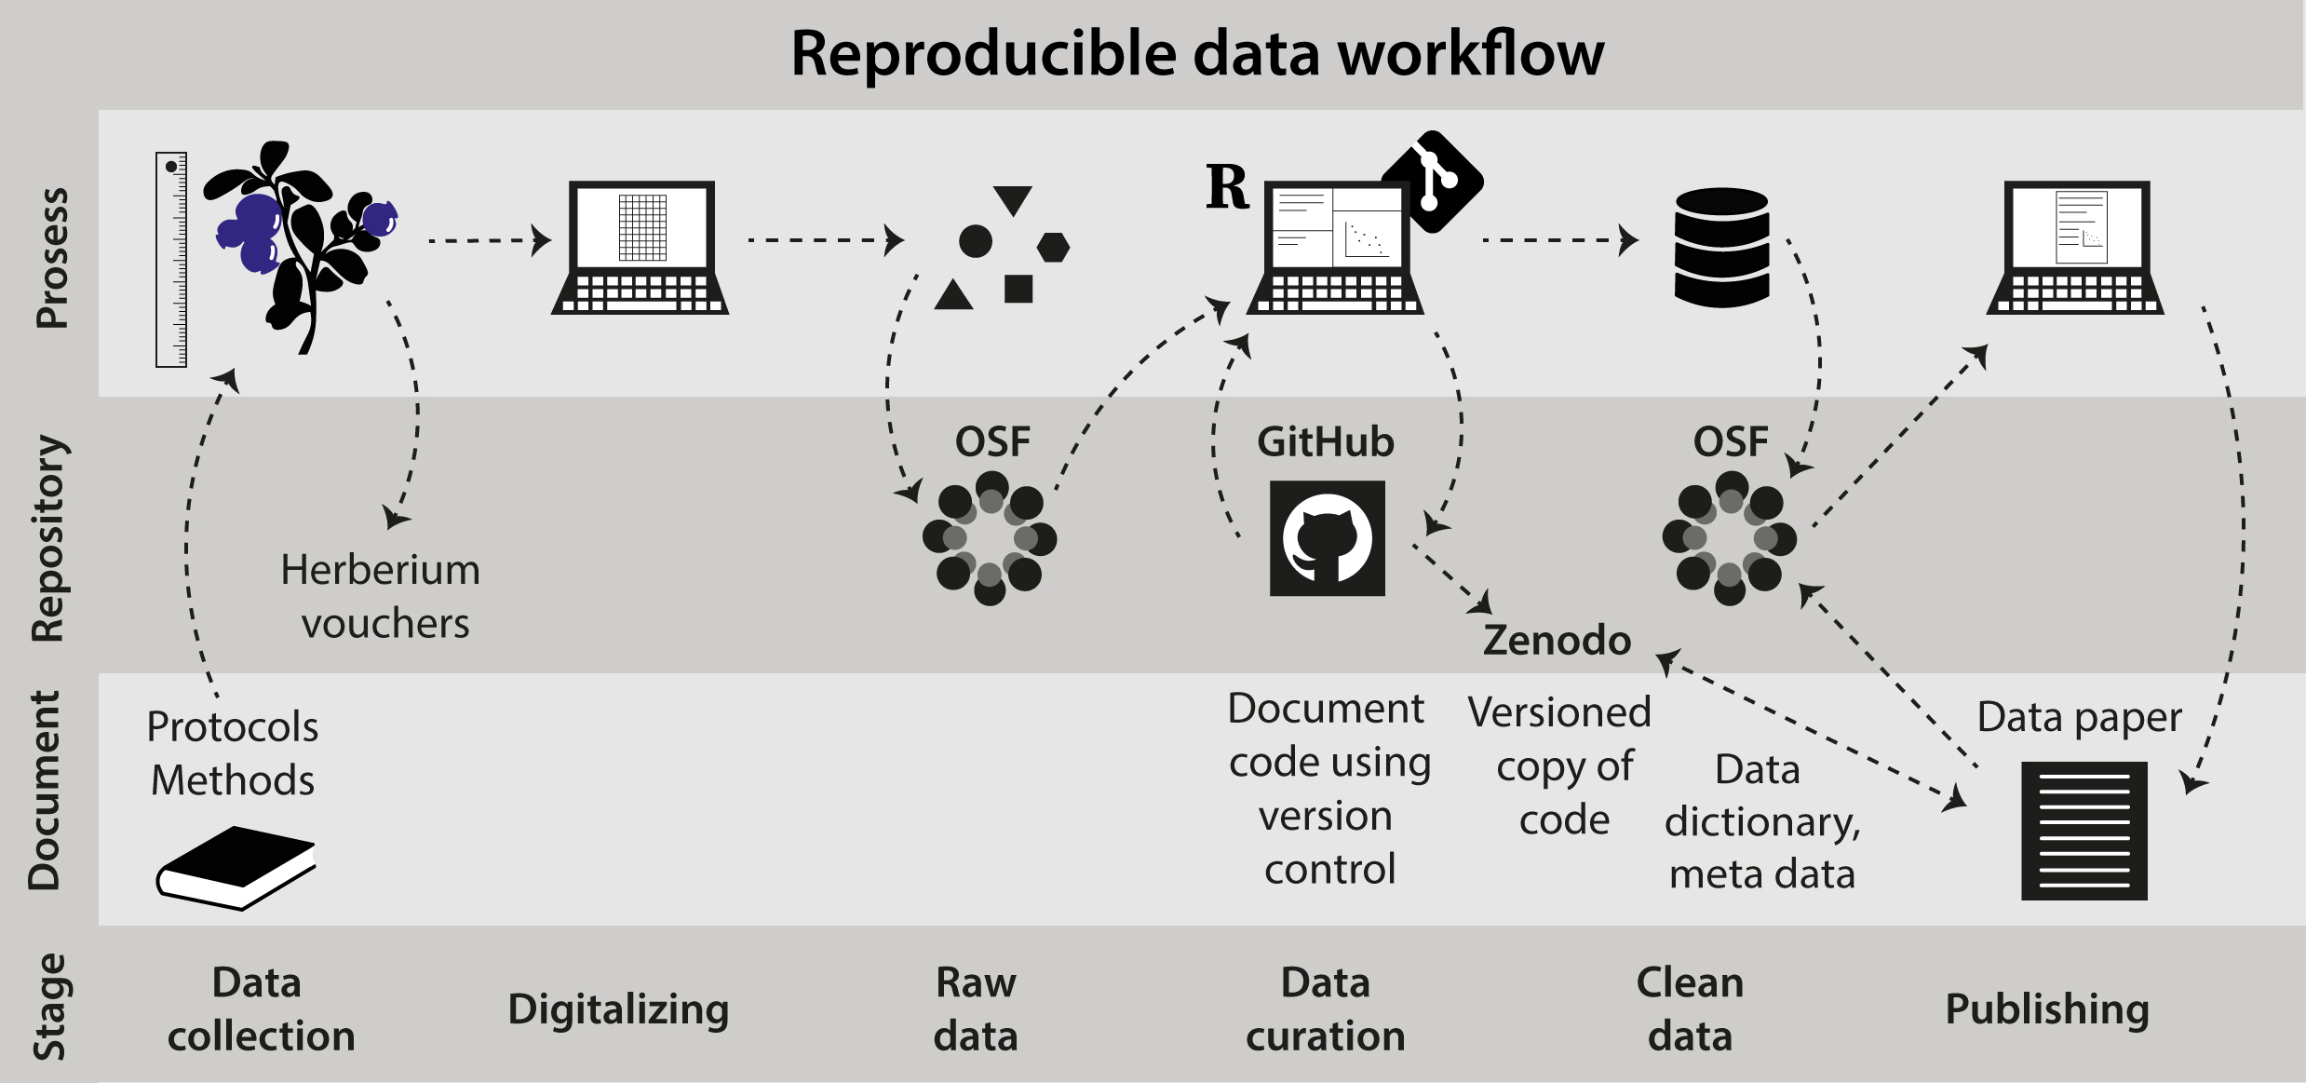
Process data – Why reproducible workflow

Slide 28

Reproducible workflows What is the targets package?
Pipeline tool for statistics and data science in R
Reproducible workflows avoiding repetition
Skips costly running time for up to date tasks
Source: https://github.com/ropensci/targets

Slide 29
When is targets useful?
Code has long runtimes (slow or complex)
Interconnected tasks with dependencies
Different outputs (e.g. paper, presentation using Rmarkdown/quarto)
import data
transformed data
vizualize
vizualize
report
tidy
model
report
model
Source: https://github.com/ropensci/targets

Slide 30
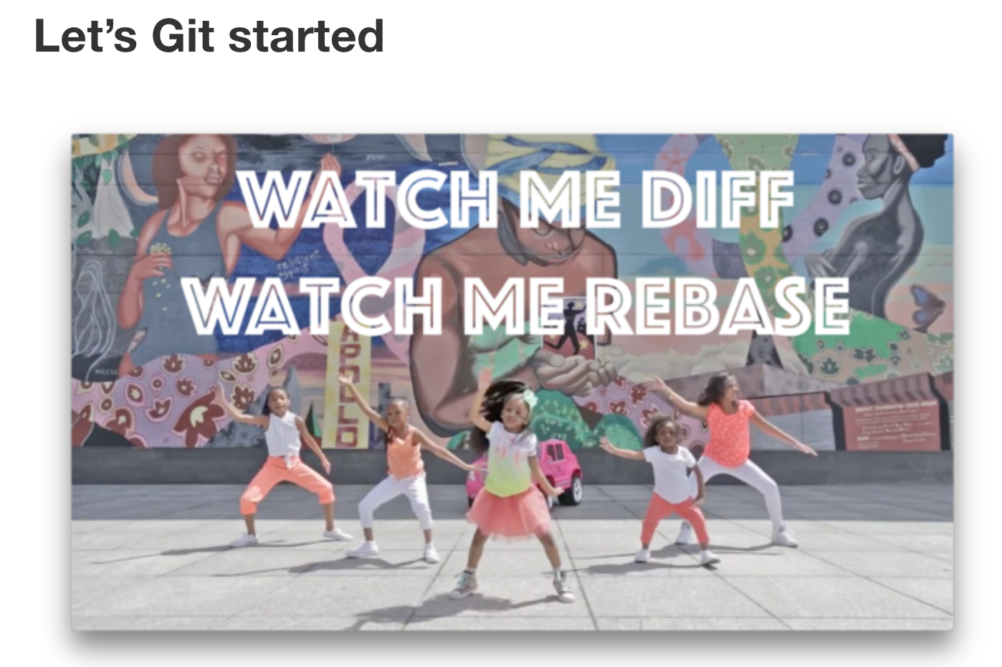
Further reading
PFTC teaching material: https://plant-functional-trait-course.github.io/PFTC_teaching_material/index.html
Jenny Bryan: https://happygitwithr.com/
Git flight rules: https://github.com/k88hudson/git-flight-rules

Slide 31
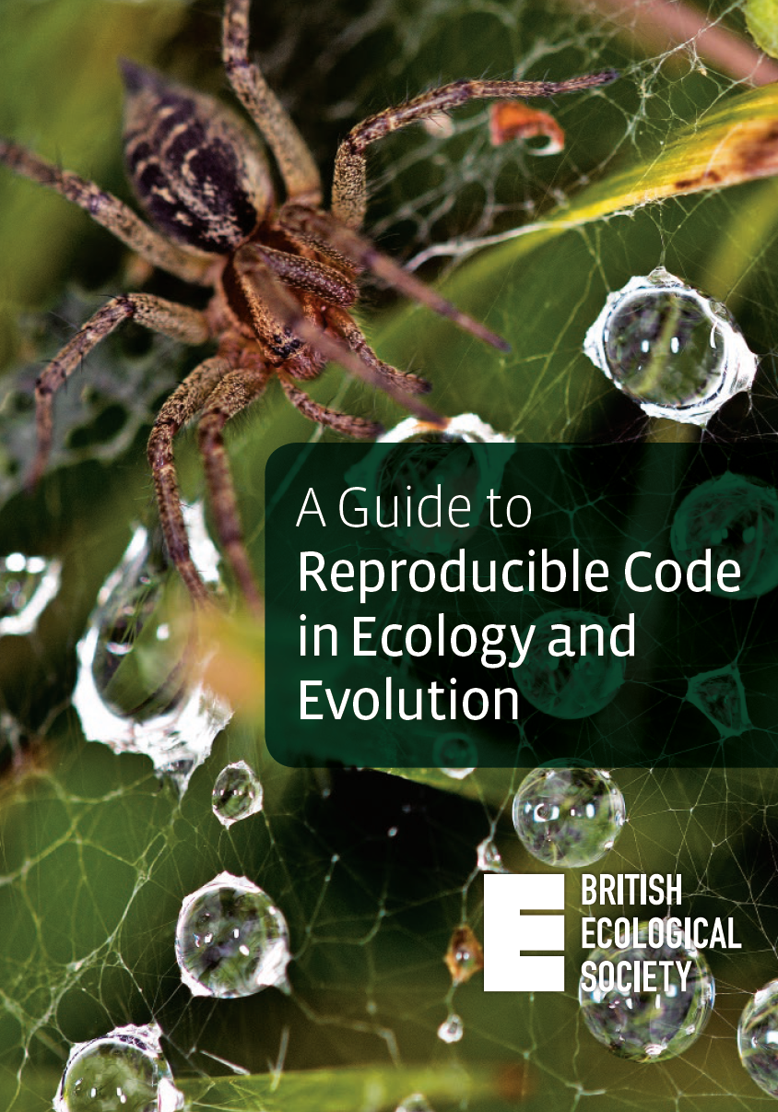
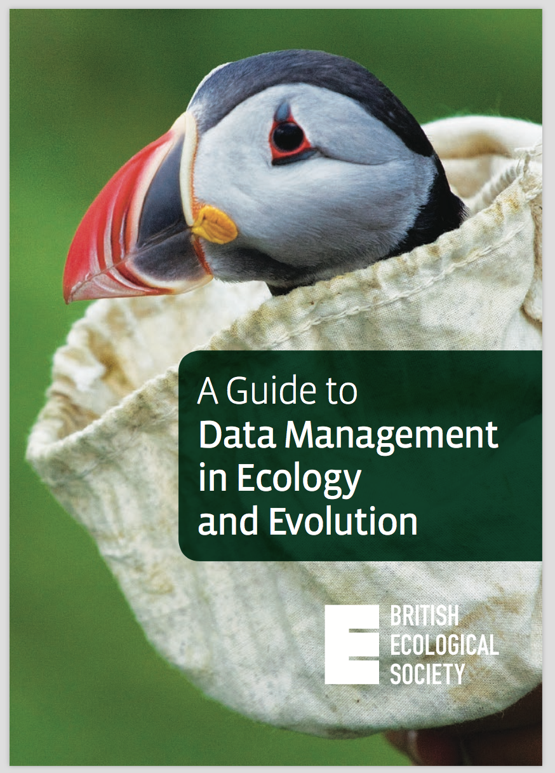
Further reading

